Slide 1
Dr. Sunirmal Khatua
Cellular Networks : 3G and 4G
Presented By
Visvesvaraya Young Faculty Fellow, Govt. of India
Assistant Professor, University of Calcutta
Notes:
We celebrate Christmas to remember the birth of Jesus Christ

Slide 2
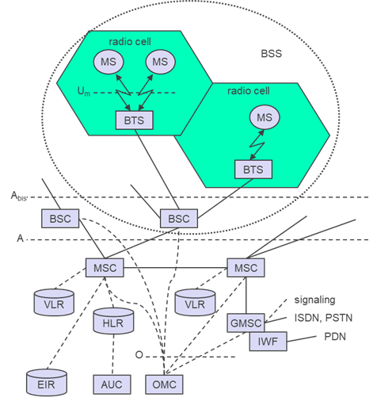
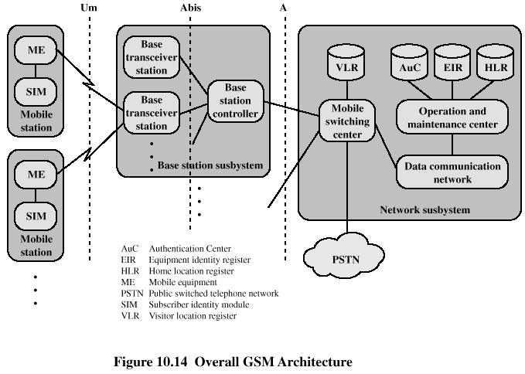
Second Generation Cellular Networks : 2G

Slide 3
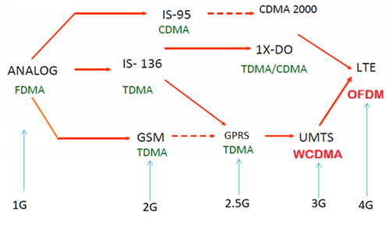
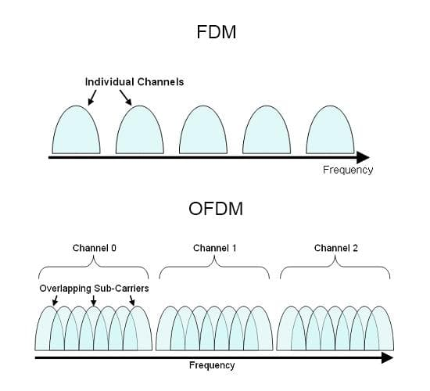
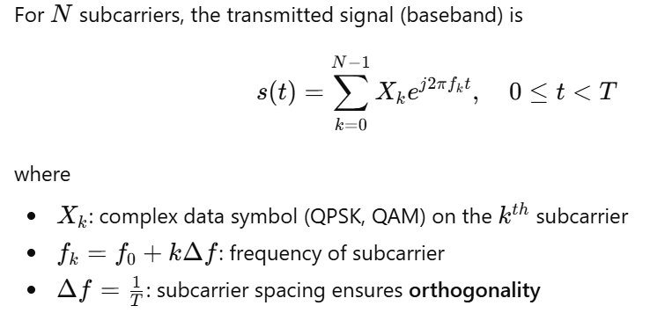
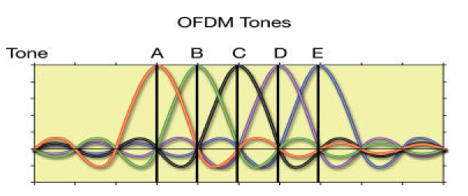
Second Generation Cellular Networks : 2G
Feature | CDMA (IS-95 / CDMA2000) | WCDMA (UMTS)
Generation | 2G/2.5G | 3G
Bandwidth | 1.25 MHz (Narrowband) | 5 MHz (Wideband)
Data Rate | Up to 153 kbps (CDMA2000 1x), 2.4 Mbps (1xEV-DO) | Up to 2 Mbps (Release 99), 14 Mbps (HSDPA)
Control Architecture | BSC (Base Station Controller) | RNC (Radio Network Controller)
Single carrier vs multi carrier

Slide 4
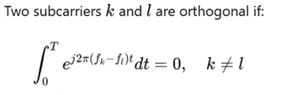
Second Generation Cellular Networks : 2G
Feature | CDMA (IS-95 / CDMA2000) | WCDMA (UMTS)
Generation | 2G/2.5G | 3G
Bandwidth | 1.25 MHz (Narrowband) | 5 MHz (Wideband)
Data Rate | Up to 153 kbps (CDMA2000 1x), 2.4 Mbps (1xEV-DO) | Up to 2 Mbps (Release 99), 14 Mbps (HSDPA)
Control Architecture | BSC (Base Station Controller) | RNC (Radio Network Controller)
Single carrier vs multi carrier

Slide 5
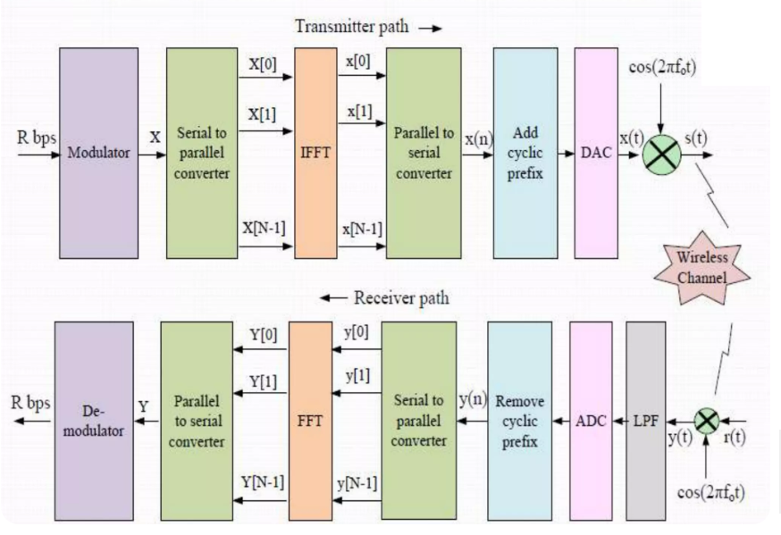
Second Generation Cellular Networks : 2G
Feature | CDMA (IS-95 / CDMA2000) | WCDMA (UMTS)
Generation | 2G/2.5G | 3G
Bandwidth | 1.25 MHz (Narrowband) | 5 MHz (Wideband)
Data Rate | Up to 153 kbps (CDMA2000 1x), 2.4 Mbps (1xEV-DO) | Up to 2 Mbps (Release 99), 14 Mbps (HSDPA)
Control Architecture | BSC (Base Station Controller) | RNC (Radio Network Controller)

Slide 6
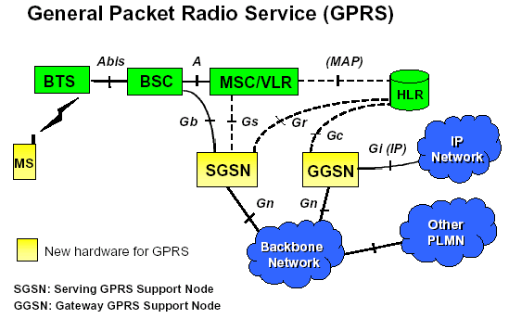
General Packet Radio Network (GPRS) : 2.5G

Slide 7
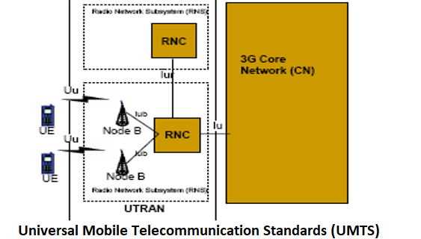
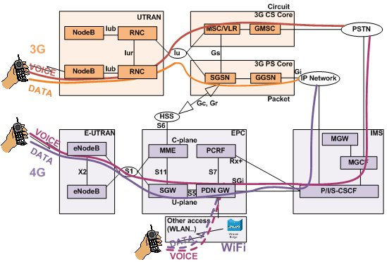
Universal Mobile Telecommunications Standards (UMTS) : 3G
3G and earlier maintains two data paths
Circuit switched: Voice calls (8kbps) and SMS/MMS
Packet switched: All IP data

Slide 8
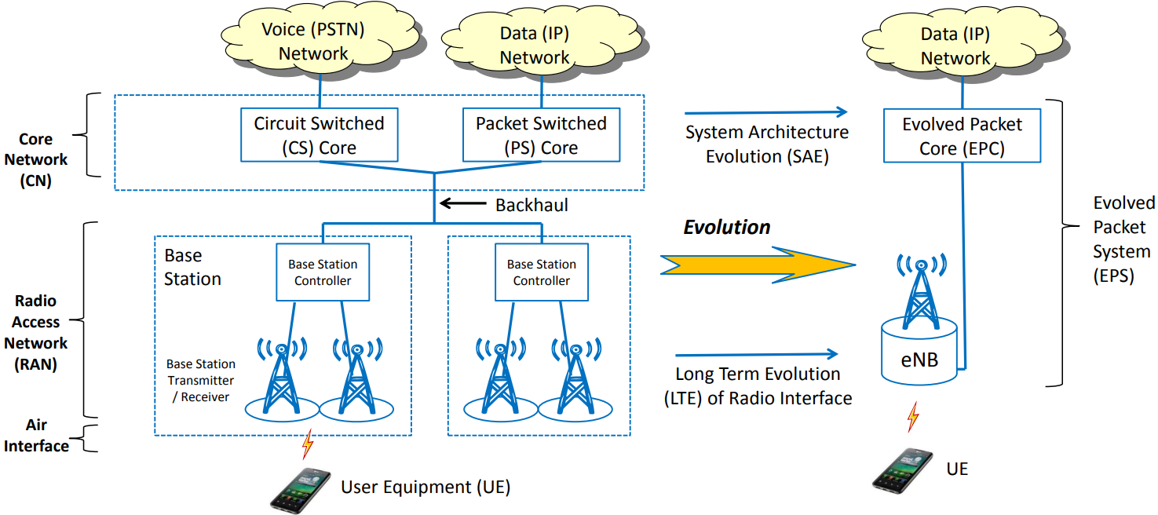
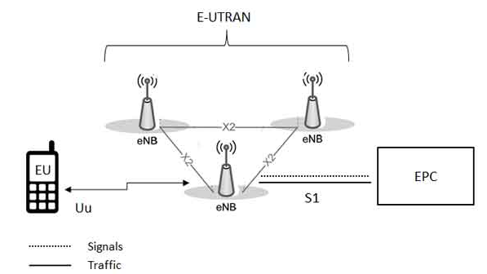
Long Term Evolution(LTE) : 4G

Slide 9
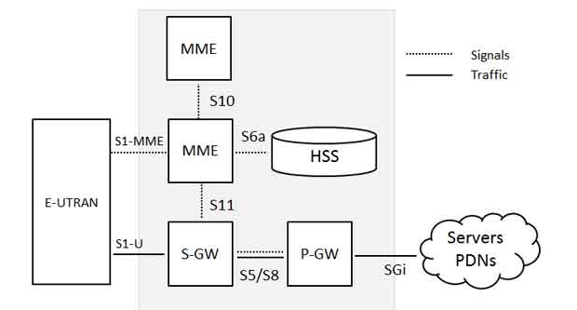

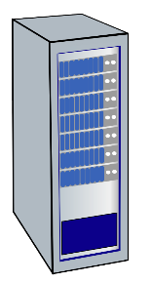




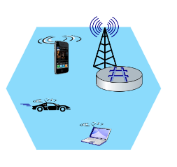
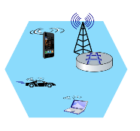
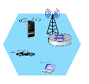
Long Term Evolution(LTE) : 4G
Long-Term Evolution (LTE) uses “all IP” approach
Everything over IP, including voice
S-GW (Serving Gateway) replaced SGSN, P-GW replaces GGSN
Mobility Management Entity (MME)
Home Subscriber Service (HSS)
Mobile device
(UE)
Base station
(eNode-B)
to
Internet
PDN gateway (P-GW)
…
Serving Gateway (S-GW)

Slide 10
Long Term Evolution(LTE) : 4G
Long-Term Evolution (LTE) uses “all IP” approach
Everything over IP, including voice
S-GW (Serving Gateway) replaced SGSN, P-GW replaces GGSN
Notes:
IMS - IP Multimedia Subsystem
PCRF - Policy and Charging Rules Function.

Slide 11
Questions?
Thank You

